Slide 1
COMBINING HETEROGENEOUS MODELS FOR MEASURING RELATIONAL SIMILARITY
Alisa Zhila, Instituto Politecnico Nacional, Mexico
Scott Wen-tau Yih, Chris Meek, Geoffrey Zweig, Microsoft Research, Redmond
Tomas Mikolov, BRNO University of Technology, Czech Republic (currently at Google)
NAACL-HLT 2013
Notes:
Presenting everybody
Joint work while on the internship at Microsoft Research…

Slide 2
Introduction: Relations in word pairs
Part-of wheel : car
Used In: Relational Search, Product Description
Synonyms car : auto
Used In: Word hints, translation
Is-A dog : animal
Used In: Taxonomy population
Notes:
Goal of my the work
Identify the relation between two given words
Go beyond simple “semantic similarity or relatedness”
AZ: I added a “retirement : pension” example to illustrate more complicated relations

Slide 3
Introduction: Relations in word pairs
More examples:
Cause-effect joke : laughter
Time:Associated Item retirement : pension
Mass:Portion water:drop
Activity:Stage shopping:buying
Object:Typical Action glass:break
Sign:Significant siren:danger
…
Many types of various relations!!!
Used In: Semantic structure of a document,
event detection, word hints…

Slide 4
Relational Similarity
Building a general “relational similarity” model
is a more efficient way to learn a model for
any arbitrary relation [Turney, 2008]
Prototype pairs:
ornithology:birds, psychology:mind,
astronomy:stars, ballistics:projectile
Target pairs:
herpetology:salamander, school:students
Relation type:
Knowledge

Slide 5
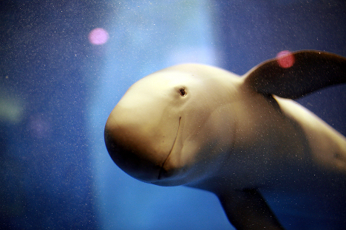
Degrees of relational similarity
Is-A relation
mammal: primate
mammal: whale
mammal: porpoise
ENTITY:SOUND
dog : bark
car : vroom
cat : meow
Binary decision on a relation loses these shades.
Notes:
Intuition of Degrees of Relational Similarities:
Not just simple discrete relation classification, but also the “degree” (e.g., more formally Prob[(whale,mammal) $∈$ Is-A]), continuous real values

Slide 6
Problem
Given a few prototypical pairs:
mammal: whale, mammal:porpoise
Determine which target pairs express the same relation:
mammal: primate, mammal: dolphin, astronomy:stars
And to what degree:
Prob[word pair_{i} ∈ relation R_{j}]

Slide 7
Contributions
Introduced Directional Similarity model
Core method for measuring of relation similarity degrees
Outperform the previous best system
Exploited advantages of existing relation similarity models by combining heterogeneous models
Achieved even better performance
Evaluated on SemEval-2012 Task 2:
Measuring Degrees of Relational Similarity
Up to 54% improvement over previous best result

Slide 8
Outline
Introduction
Heterogeneous Relational Similarity Models
General Relational Similarity Models
Relation-Specific Models
Combining Heterogeneous Models
Experiment and Results
Conclusions and Future Work

Slide 9
General Models: Directional Similarity Model 1/2
Prototype pair: clothing : shirt
Target pair: furniture : desk
Directional Similarity Model is a variant of
Vector Offset Model [Tomas Mikolov et al., 2013 @ NAACL]
Language Model learnt through Recurrent Neural Network, RNNLM
Vector Space in RNNLM

Slide 10
General Models: Directional Similarity Model 2/2
Prototype pair: clothing : shirt
Target pair: furniture : desk
Words are represented as vectors in RNNLM
shirt
θ
desk
clothing
furniture
Relational Similarity via Cosine between word pair vectors

Slide 11
General Models: Lexical Pattern Model
[E.g. Rink and Harabagiu, 2012]
Extract lexical patterns:
Word pairs (mammal : whale), (library : books)
Corpora: Wikipedia, GigaWord
Lexical patterns: word sequences encountered between given words of a word pair
“mammals such as whales”,
“library comprised of books”
Hundreds of thousands of lexical patterns collected
Features: log(pattern occurrence count)
Train a log-linear classifier:
Positive and negative examples for a relation
Notes:
AZ: - Should I give any details on the classifier and feature selection?

Slide 12
Relation Specific Models: Knowledge Bases
Relation-specific information from Knowledge Bases
Probase [Wu et al., 2012]
> 2.5M concepts
Relations between large part of the concepts
Numerical Probabilities for relations
For (furniture : desk) gives Prob[(furniture : desk) ∈ Relation R_{j}]
We considered relations:
Is-A weapon:knife, medicine:aspirin
Attribute glass:fragile, beggar:poor

Slide 13
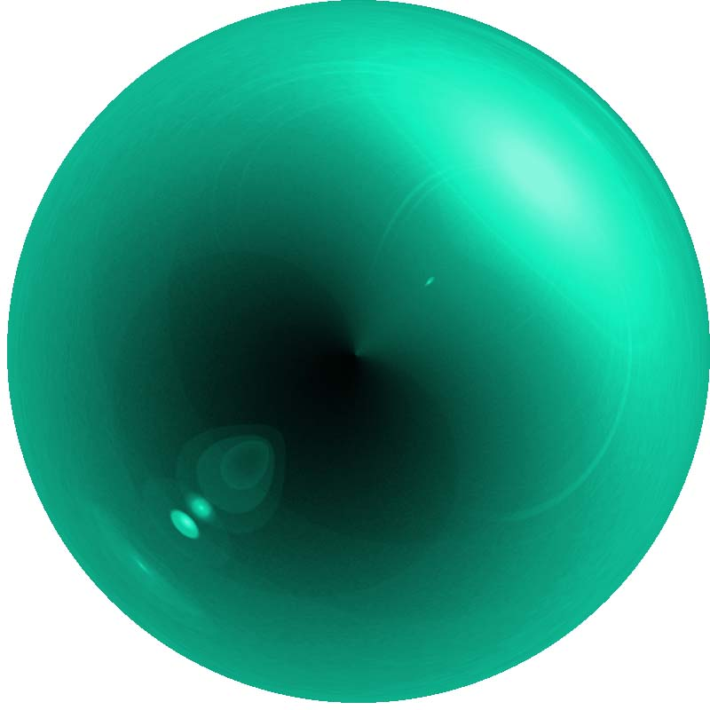
Relation Specific Models: Lexical Semantics Measures
Polarity-Inducing Latent Semantic Analysis, PILSA
[Yih et al. 2012]
Distinguishes between Synonyms and Antonyms
Vector Space model
Words represented as unit vectors
Words with opposite meanings correspond to oppositely directed vectors
Degree of synonymy/antonymy measured as cosine
burning
hot
cold
freezing

Slide 14
Combining Heterogeneous Models
Learn an optimal linear combination of models
Features: outputs of the models
Logistic regression:
regularizers L1 and L2 selected empirically
Learning settings:
Positive examples:
ornithology:birds, psychology:mind,
astronomy:stars, ballistics:projectile
Negative examples:
school:students, furniture:desk, mammal:primate
Learns a model for each relation/prototype pair group

Slide 15
Outline
Introduction
Heterogeneous Relational Similarity Models
Experiment and Results
Task & Dataset
Results
Analysis of combined models
Conclusions and Future Work
Notes:
AZ: Should we do a (very high-level) overview of other methods, what approaches they used? Or is it a waste of time?

Slide 16
Task & Dataset 1/2
SemEval 2012 Task 2:
Measuring Degrees of Relational Similarity
3-4 prototype pairs for 79 relations in 10 main categories:
Class Inclusion, Attribute, Case Relations, Space-Time…
40 example pairs in a relation
Not all examples represent the relation equally well
an X indicates/signifies Y
" siren:danger " "signature:approval " "yellow:caution"
Gold Standard Rankings of example word pairs per relation
ranked by degrees of relational similarity
based on inquiries of human annotators
Notes:
-

Slide 17
Task & Dataset 2/2
Task: automatically rank example pairs in a group and evaluate against the Gold Standard
Evaluation metric:
Spearman rank correlation coefficient ρ
How well an automatic ranking of pairs correlates
with the gold standard one by human annotators
Settings:
10 relations in a development set with known gold standard rankings
69 relations in a testing set

Slide 18
Approaches to Measuring Relational Similarity Degree
Duluth systems [Pedersen, 2012]
Word vectors based on WordNet + cosine similarity
BUAP system [Tovar et al., 2012]
Word pair represented in a vector space + Cosine between target pair and a prototypical example
UTD systems [Rink and Harabagiu, 2012]
Lexical patterns between words in a word pair + Naïve Bayes Classifier or SVM classifier
Some systems were able to outperform the random baseline, yet there was still much room for improvement

Slide 19
Results: Averaged Performance
54.1 % improvement
Co-HM
Notes:
AZ: How should we call our system? How about: CoHM or Co-HM = Combination of Heterogeneous Models?

Slide 20
Results: Per Relation Group
Relation Groups | UTD-NB | Co-HM
1 CLASS INCLUSION
2 PART-WHOLE
3 SIMILAR
4 CONTRAST
5 ATTRIBUTE
6 NON-ATTRIBUTE
7 CASE RELATION
8 CAUSE-PURPOSE
9 SPACE-TIME
10 REFERENCE
9 winning cases out of 10

Slide 21
Analysis: Model Ablation Study
From a combined model take out each individual model one by one:
-Is-A -Attribute -DS -PILSA -Patterns
-DS shows substantial drop in performance:
33% drop in Spearman’s ρ (0.353 → 0.238 )
Ablation of other models does not show statistically significant change in result
However, combining all the models together gives great improvement compared to DS model only
9% increase in Spearman’s ρ (0.324 → 0.353)

Slide 22
Outline
Introduction
Heterogeneous Relational Similarity Models
Experiment and Results
Conclusions and Future Work
Notes:
AZ: Should we do a (very high-level) overview of other methods, what approaches they used? Or is it a waste of time?

Slide 23
Conclusions & Future Work
State-of-the-art results
Introduced Directional Similarity model
A general model for measuring relational similarity for arbitrary relations
Introduced combination of heterogeneous
– general and relation-specific – models
for even better relational similarity measuring
In the future:
How to choose individual models for specific relations?
User study for relation similarity ceiling
Compare various VSM (RNNLM vs. others)
Thank you!
Notes:
We achieve the new state-of-the-art on this task
How? (or, how is it different from existing approaches)
Features?
Different ML settings/models?
Future Work:
Directions for further improvement
Current analysis indicates some possible directions
More error analysis
Examine the effectiveness of the current model and its application
Is our model good enough?

Slide 24
Additional slides
(mostly old slides from the internship presentation)

Slide 25
Contributions

Slide 26
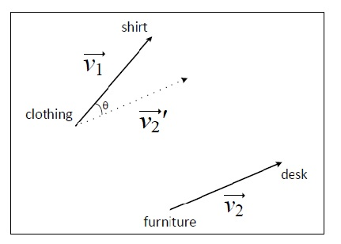
Directional Similarity Model
Prototype pair: furniture : desk
Target pair: clothing : shirt
Word Embedding
$\vec{w1},\vec{w2}$ and $\vec{p1},\vec{p2}$
Vectors from Recurrent Neural Network Language Model (RNNLM, Mikolov et al., 2013)
Word pair vectors: $\vec{w1:w2}= \vec{w1} −\vec{w2}$
Word pair vector similarity:
$$\cos{(\vec{w1:w2},\vec{p1:p2})}$$
Accuracy 41.2 (up 4.5%) Spearman 0.234 (up 18%)
Notes:
AZ: Should I keep the resutling numbers?

Slide 27
Task: Select Good/Bad Pairs
SemEval 2012 Task 2:
Measuring Degrees of Relational Similarity
Randomly select 4 pairs from a group of 40 pairs
Present them to a human annotator to choose the best and the worst one:
Taxonomy: Y is a type of X
"oak:tree" "vegetable:carrot " "tree:oak" "currency:dollar"
~100 questions for each group covering all the pairs
Form the Gold Standard
Notes:
-

Slide 28
Dataset: Word Pairs and Relations
79 relations
10 main categories:
Class Inclusion
Part-Whole
Similarity
Contrast
Attribute
Non-Attribute
Case Relations
Cause-Purpose
Space-Time
Reference
5-9 finer relation groups in each category
79 groups × 40 word pairs
Notes:
Two-layer hierarchy
10 main categories of word relations
Class-inclusion, part-whole, similarity, contrast, attribute
Non-attribute, case relations, cause-purpose, space-time, reference
Each one of them has several more fine-grained subcategories of relations
79 word relations in total
Each group (relation) has 40 word pairs (some are good, some are bad)

Slide 29
Applications (??? Delete it)
Search
Relational search: ranked results
Parts of a car: wheel, bumper, …, windshield wiper
Analogy search:
dogs : bark = cows : ?
Education
GRE, SAT tests
lull : trust
balk : fortitude
betray : loyalty
cajole : compliance
hinder : destination
soothe : passion
How easy/difficult is it to determine that two word pairs express the same relation?
Semantic parsing and matching
Notes:
Used in search, for students and ESL learners, semantic parsing
AZ: I cannot come up with a good example for semantic parsing…

Slide 30
Relation Specific Models: Knowledge Bases
Relation-specific information from KB’s
Knowledge base: Probase (Wu et al., 2012)
Relations: Is-A and Attribute
Probase contains probabilities of a relation between two concepts:
For (clothing : shirt) returns Prob[(clothing : shirt) $∈$ Is-A]
For (poverty : beggar) → Prob[(beggar : poverty) $∈$ Attribute]

Slide 31
RNN Language Model
Word vector embeddings $\vec{w1},\vec{w2}$
Word pair vectors: $\vec{w1:w2}= \vec{w1} −\vec{w2}$
Each group has 3 “gold standard” example pairs out of the list : $\vec{g1:g2}$
Word pair vector similarity:
$$\cos{(\vec{w1:w2},\vec{g1:g2})}$$

Slide 32
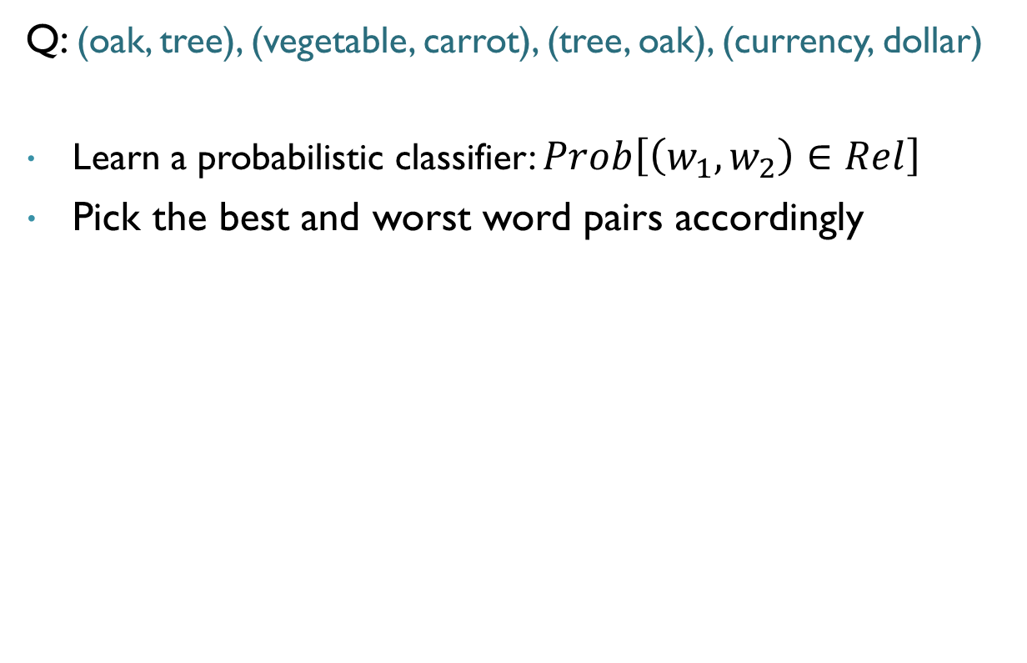
Methodology: Learning Model
Q: (oak, tree), (vegetable, carrot), (tree, oak), (currency, dollar)
Learn a probabilistic classifier: $Prob\left[\left(w_{1},w_{2}\right)∈Rel\right]$
Pick the best and worst word pairs accordingly

Slide 33
Methodology: Learning Model
Training
36 positive examples
3000 negative
Testing
4 word pairs in question
Rank pairs using a classifier
Train a separate model for each 4 pair question (8000 models in total)
For each 4 testing pairs determine best ranked and worst ranked
Notes:
36 positive examples
Word pairs in the same category but not in the question
3000 negative examples
Word pairs in other categories

Slide 34
Methodology
Features:
word-pair scores from existing models
Knowledge Bases: Probase IsA and Attribute (Wang et al., MSR)
Synonym/Antonym: PILSA (Yih et al., MSR)
Vector Similarity: RNN language model (Zweig and Mikolov, MSR)
Corpus-based context or pattern features
X:Y -> ‘X of the Y’
Classifier:
TLC FastRank
Notes:
Two types of features:
word-pair scores from existing models
E.g., Capture some specific relations
Need to verbally explain what they are
WordSim features?
Corpus-based context or pattern features
Examples
Learning algorithm:
- TLC FastRank (but heavily regularized, /nl:2, ~20 features used; probabliy simialr to LR with L1 regularization)

Slide 35
Analysis
Class Inclusion -Taxonomic
"art:abstract","bread:wheat","pet:dog“(0.360), "dog:pet“ (0.002)
Probase IS-A
‘such as’
Part-Whole -Collection:Member
"herd:elephant","flock:bird","soldiers:army“(0.049),"library:book“(0.991)
‘consisting of’
‘of’

Slide 36
Analysis: Model Ablation Study
Relation Groups | Co-HM | - Attr | - IsA | - PILSA | - DS | - Pat
CLASS-INCLUSION
PART-WHOLE | max
SIMILAR | max
CONTRAST
ATTRIBUTE
NON-ATTRIBUTE
CASE RELATIONS
CAUSE-PURPOSE
SPACE-TIME | max
REFERENCE
Average
Changes in Spearman’s ρ
Notes:
Here we show the changes for Spearman’s rho. The main tendency is very similar for MaxDiff Accuracy (not included).
Down Arrows show absence of which feature gave the lowest output. It means that not including this feature in the combination might worsen the performance.
As we can observe, the Directional Similarity Method is the critical component. All differences in performance are statistically significant.
IsA has an important impact on Class-Inclusion Group.
Benefits of Attribute and PILSA are unclear. Additionally, the differences in performance are not statistically significant.
Lexical Pattern general model is les critical than Directional Similarity.
Up Arrows show absence of which feature gave a maximum increase higher than the output of the Combination of all models. It happens because some models do not produce useful signals for particular relation groups. This effect can be alleviated when there are enough quality training data.

Slide 37
Analysis – Room for Improvement
SPACE-TIME – Time: Associated Item
Example: ‘retirement:pension’
‘education and’
‘and a big’
No distinctive context patterns
No leading feature

Slide 38
Building a general “relational similarity” model
is a more efficient way to learn many, specific individual relation models [Turney, 2008]

